Slide 1
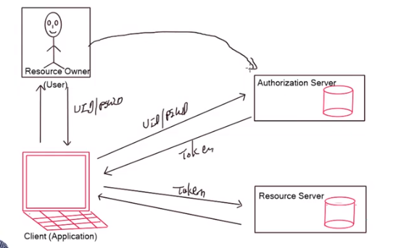

Slide 2
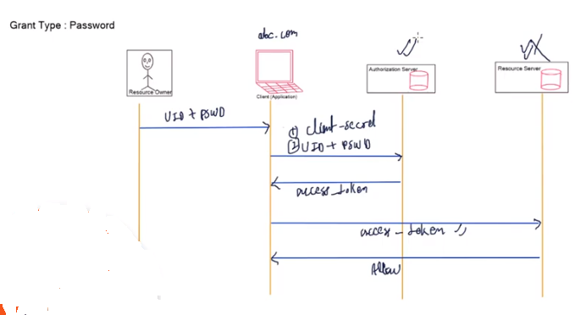

Slide 3
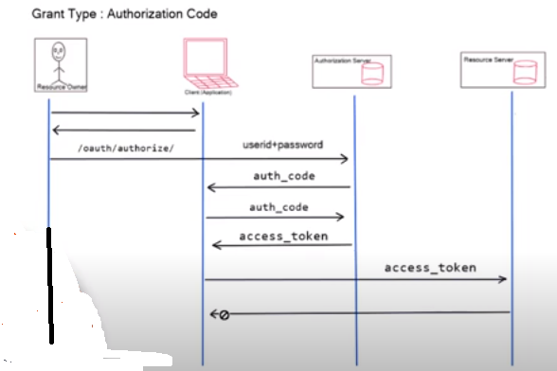

Slide 4
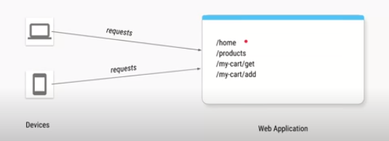

Slide 5
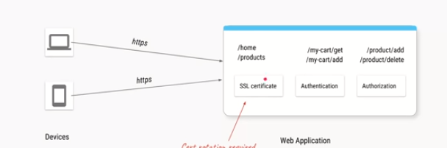

Slide 6
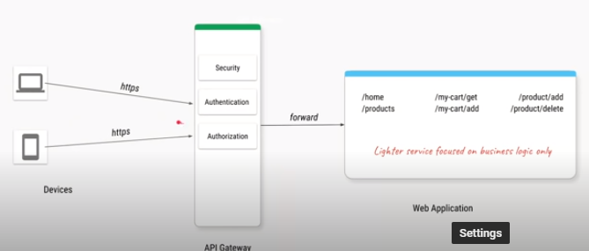

Slide 7
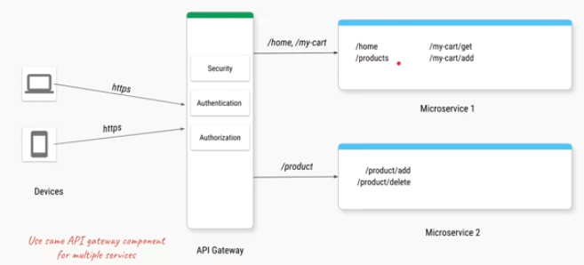

Slide 8
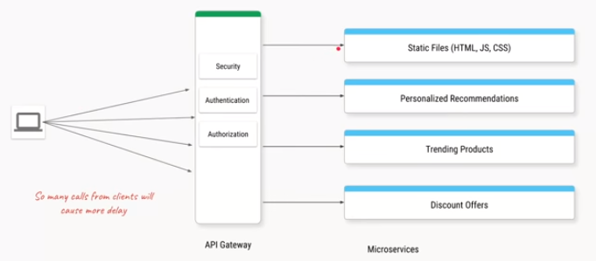

Slide 9
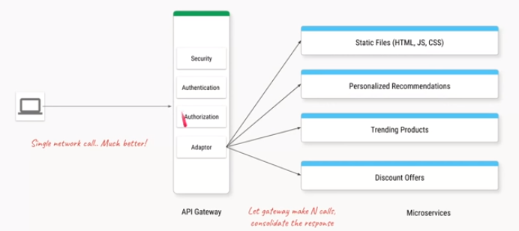

Slide 10
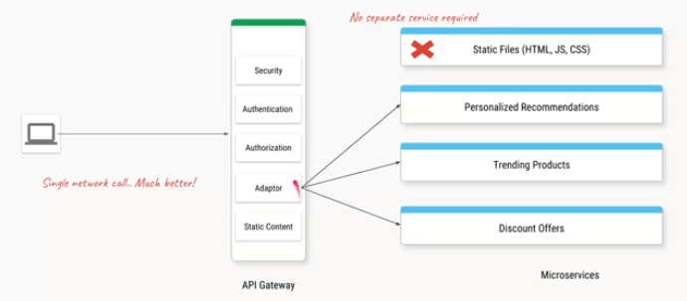

Slide 11
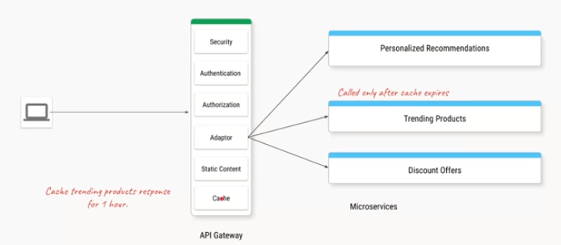

Slide 12
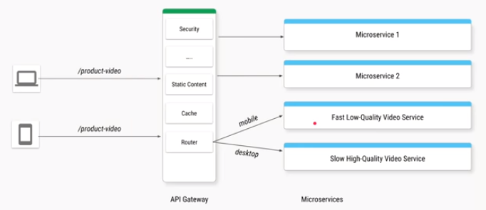

Slide 13
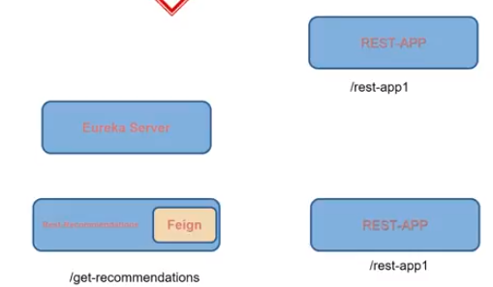

Slide 14


Slide 15
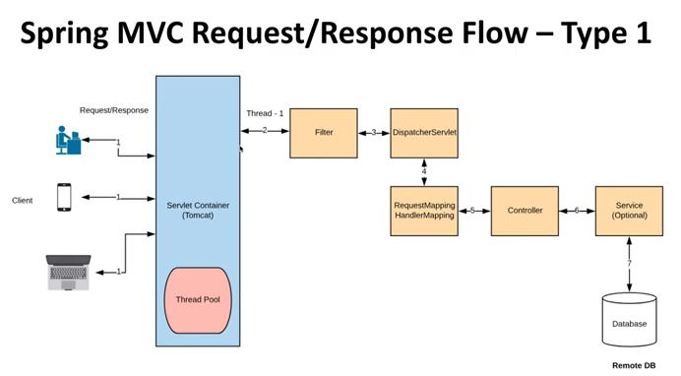

Slide 16
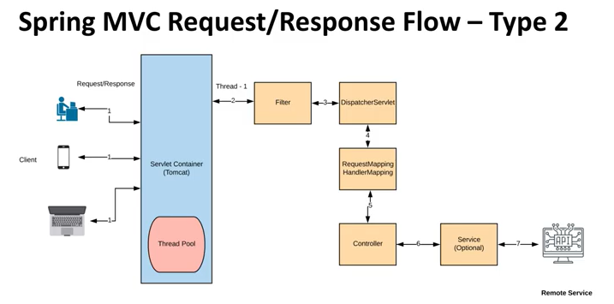

Slide 17
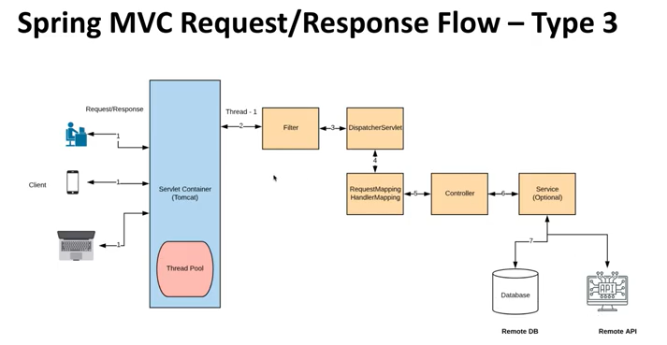

Slide 18
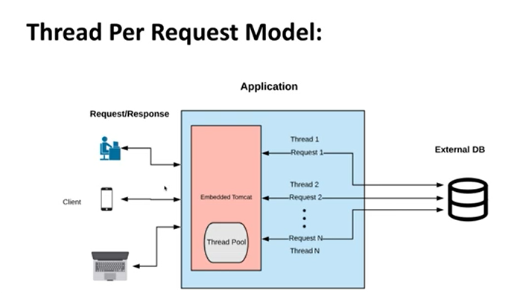

Slide 19
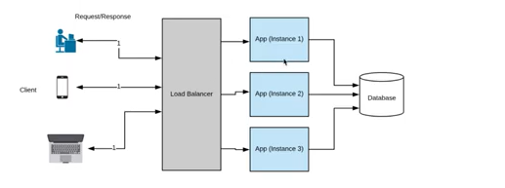
Horizontal Scaling

Slide 20
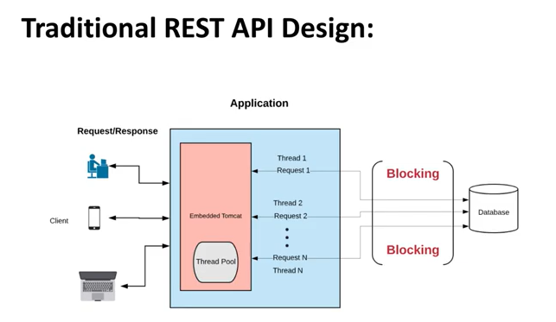

Slide 21
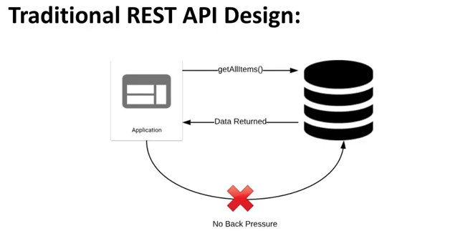

Slide 22
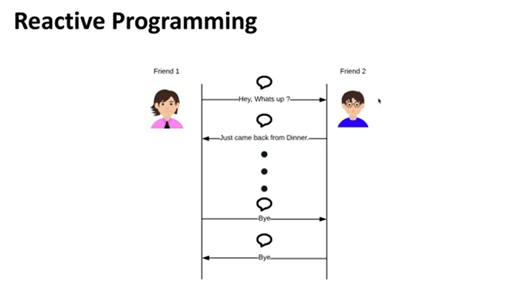

Slide 23
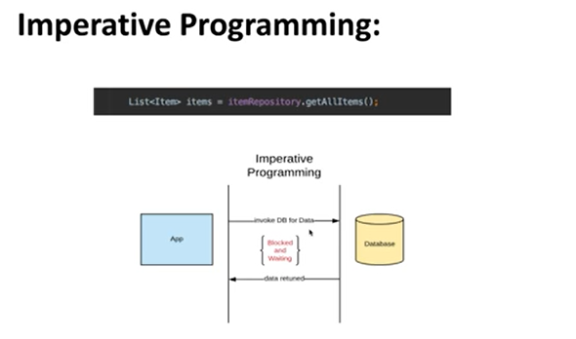

Slide 24
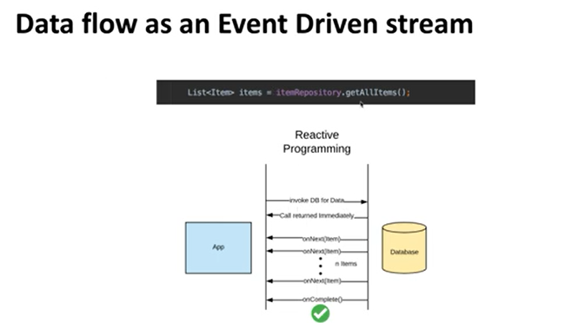

Slide 25
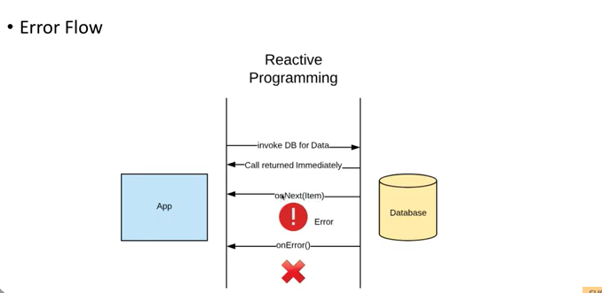

Slide 26
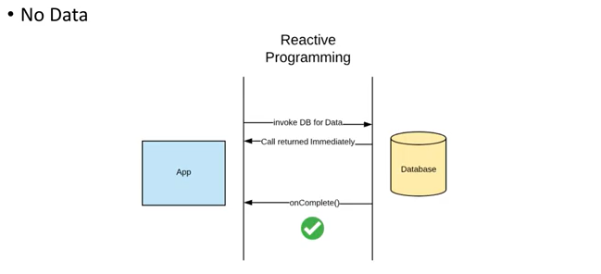

Slide 27
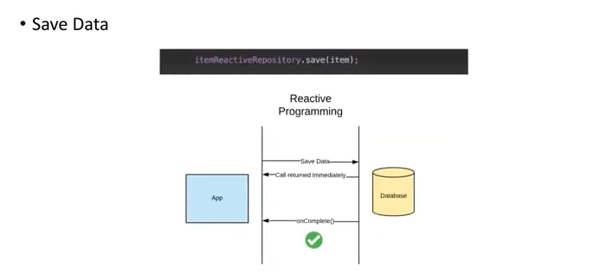

Slide 28
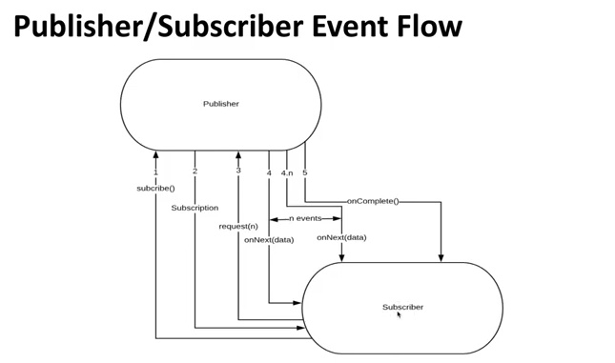

Slide 29
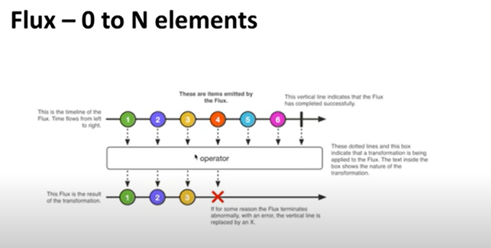

Slide 30
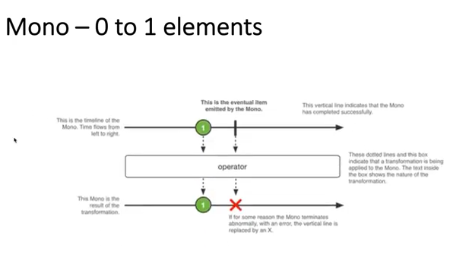

Slide 31
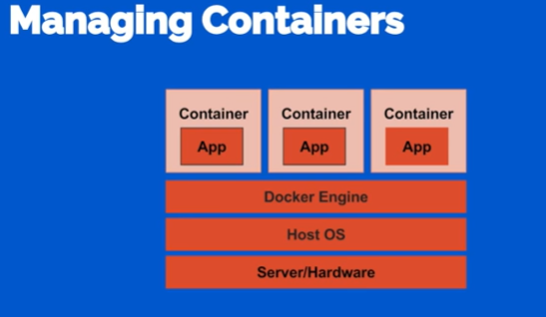

Slide 32
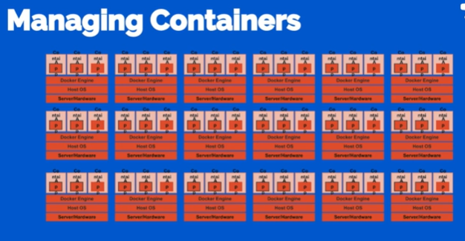

Slide 33
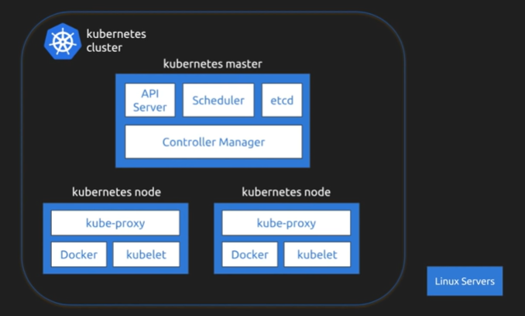

Slide 34
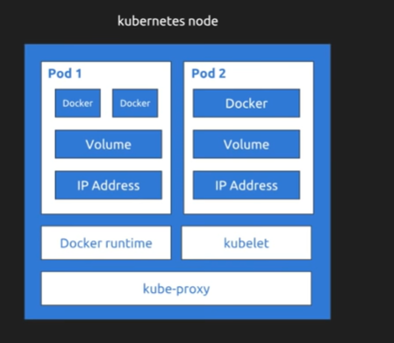

Slide 35
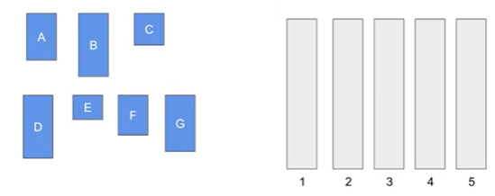
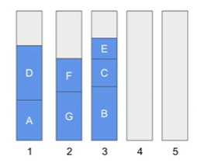
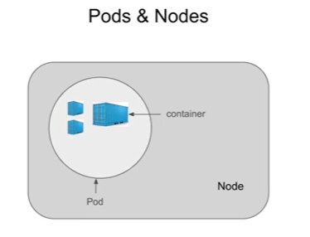
AUTOMATIC BIN PACKING

Slide 36
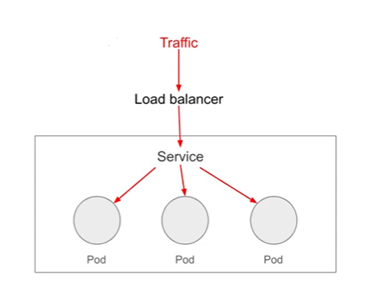
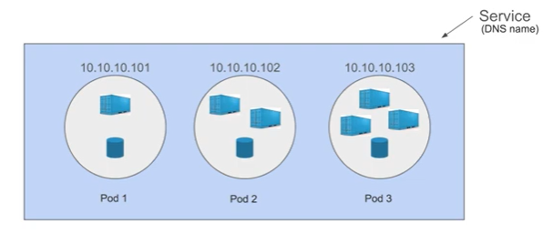
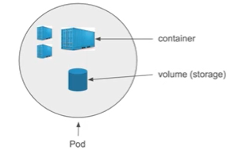
Service Discovery and Load Balancing
Storage Orchestration

Slide 37
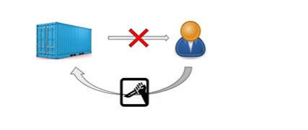
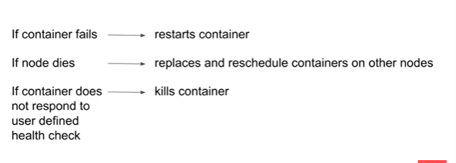
Self Healing

Slide 38
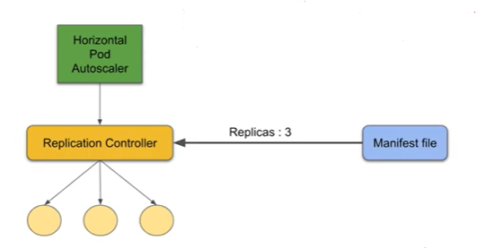
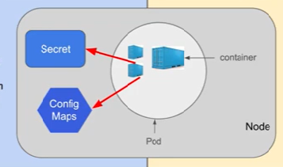
Secret and Configuration Management
Horizontal Scaling

Slide 39
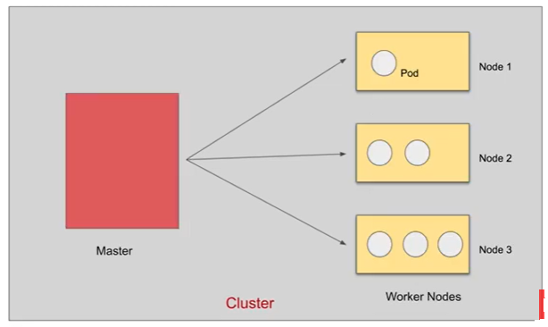
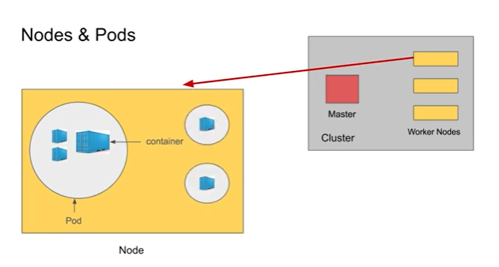
Kubernetes Architecture

Slide 40
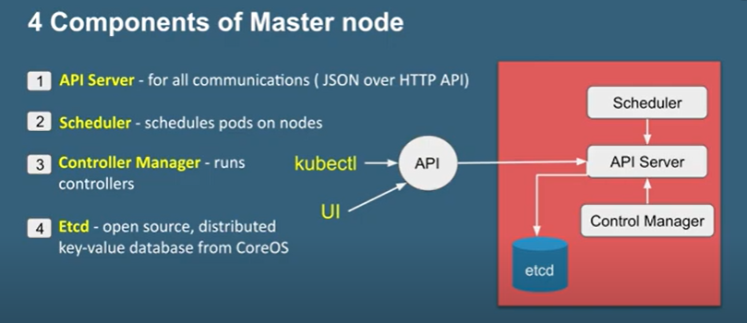
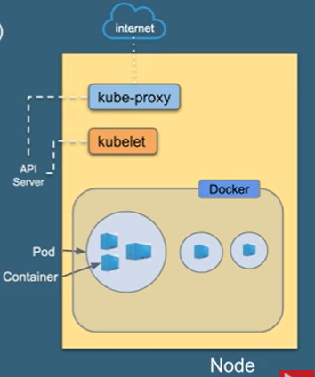
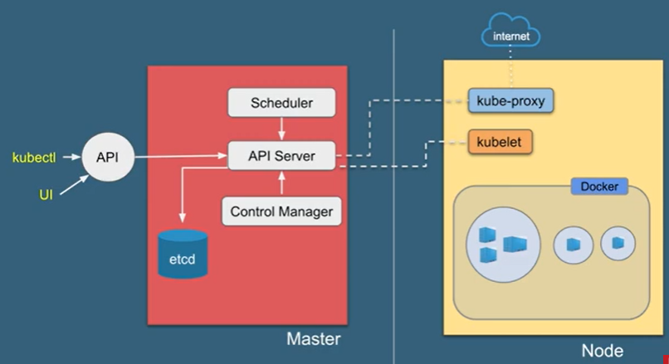
Master Node
Worker Node

Slide 41
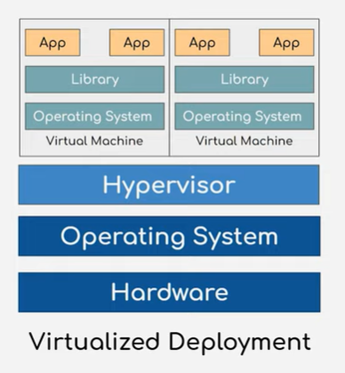
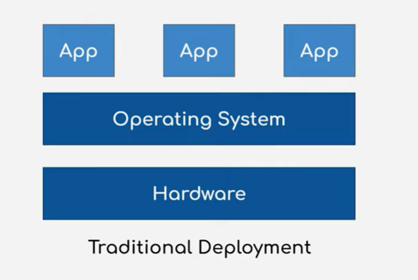
Kubernetes -DailyCodeBuffer

Slide 42


Slide 43


Pod

Slide 44


Service

Slide 45

Config Map

Slide 46

Secrets

Slide 47

Volume

Slide 48

Deployment

Slide 49

ELK Architecture

Slide 50

Spring cloud stream

Slide 51

Executor Service

Slide 52


Slide 53


Slide 54

Apache Kafka Architecture

Slide 55

Confluent Architecture

Slide 56


Slide 57

AVRO SCHEMA

Slide 58

AVRO SCHEMA EVOLUTION

Slide 59


Slide 60

Producer Serializer

Slide 61

Consumer Deserailizer

Slide 62

Authentication and Authorization

Slide 63

Basic Authentication

Slide 64


Slide 65

Oauth

Slide 66

Oauth with OpenID

Slide 67

OAuth2.0

Slide 68

Authorization code flow by Okta

Slide 69


Slide 70


Slide 71


Slide 72


Slide 73


Slide 74


Slide 76


Slide 77


Slide 78


Slide 79


Slide 80


Slide 81


Fault Tolerance

Slide 82


Slide 83

Offset Management

Slide 84


Slide 85

STREAM PROCESSING TOPOLOGY

Slide 86

Kafka Streams – Introduction

Slide 87


Slide 88


Slide 89

Kafka Stream Architecture

Slide 90


Slide 91


Slide 92


Slide 93


Slide 94

Kafka support in Spring

Slide 95


Slide 96


Slide 97


Slide 98


Slide 99


Slide 100

REAL TIME KAFKA STREAM

Slide 101


Slide 102


Slide 103


Slide 104


Slide 105


Slide 106

Exactly Once Processing

Slide 107

Ktable Usecase

Slide 108

Ktable Aggregation

Slide 109

reduce – Use case

Slide 110

aggregate() – use case

Slide 111


Slide 112

Windowing Aggregate – Use case

Slide 113


Slide 114

Tumbling window

Slide 115

Hopping Window

Slide 116

Session Window – Use case

Slide 117


Slide 118

Kstream-Kstream Join

Slide 119


Slide 120


Slide 121

Kstream Ktable Join – Use case

Slide 122


Slide 123


Ktable vs GlobalKTable

Slide 124

GlobalKTable use case

Slide 125

Complex Aggregation

Slide 126


Slide 127



Slide 128



Slide 129




Slide 130




Slide 131



Slide 132

KSQL

Slide 133


Slide 134

Kafka Connect

Slide 135


Slide 136


Slide 137


Slide 138


Slide 139


Slide 140

Kafka Connect Scalability

Slide 141


Slide 142





Slide 143


Slide 144


Slide 145


Slide 146
GRAPH QL

Slide 147


Slide 148


Slide 149


Slide 150


Slide 151

GraphQL Building Blocks

Slide 152


Slide 153


Slide 154


Slide 155


Slide 156


Slide 157


BTREE Index

Slide 158


Bitmap index

Slide 159



Function based index

Slide 160


Reverse Key index

Slide 161
DESIGN PATTERN

Slide 164
FACTORY PATTERN

Slide 166
Abstract Factory Pattern

Slide 167
ADAPTER PATTERN

Slide 168
Template pattern

Slide 169
Command Pattern

